Slide 1
Dev-Ops

Slide 2

Agenda
In this session, you will learn about:
Introduction to DevOps
Relationship between DevOps and Agile
Best Practices – DevOps
Maven and Gradle (Dependency Management)
Source Control Repository (Git & Bit Bucket)
Continuous Integration (Using Jenkins)

Slide 3
What’s DevOps

Slide 4
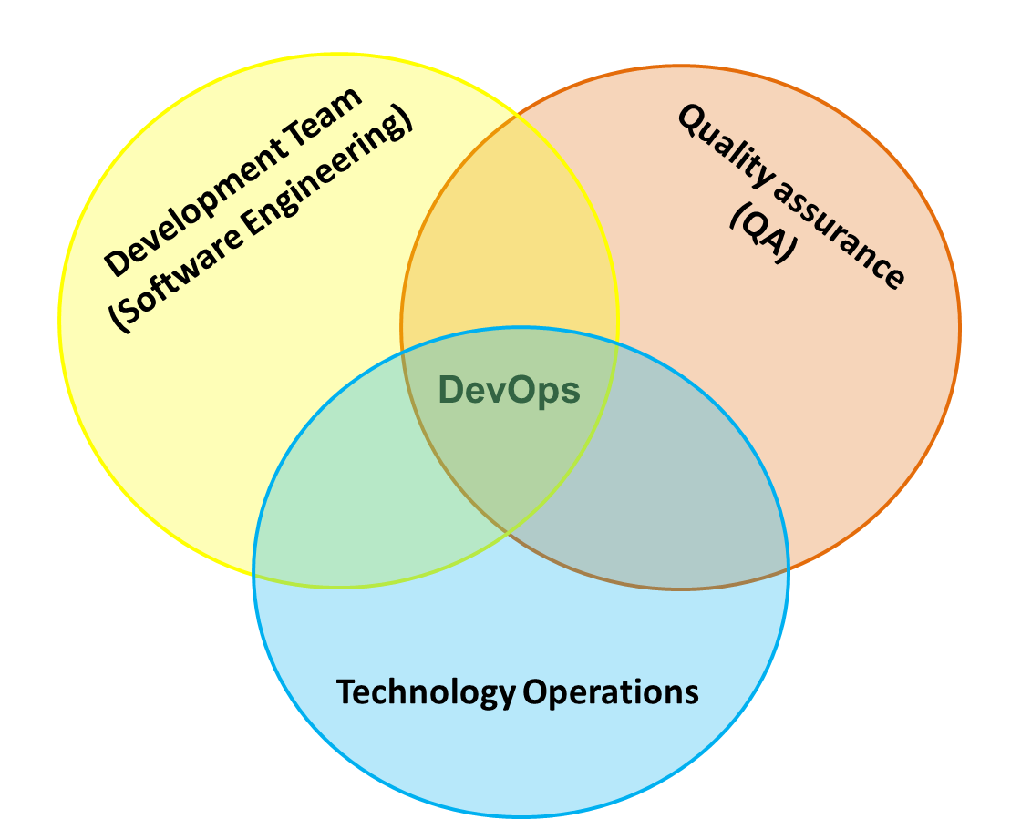
What’s DevOps?
DevOps is a software development and delivery process that emphasizes communication and collaboration between Product Development Team, QA Team, Operations Team and Business owners to increase organization's ability to deliver application and services at high velocity.
This speed enables organizations to better serve their customers and compete more effectively in the market.

Slide 5
What’s DevOps?
DevOps building blocks:
Code
Build
Test
Packaging
Release management
Configuration management
Application and Infrastructure monitoring
Development and QA Team
Operations Team

Slide 6
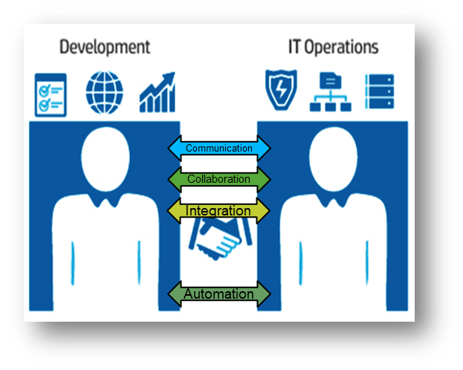
DevOps Culture
DevOps is more than just a tool or a process change; it inherently requires an organizational culture shift.
This cultural change is especially difficult, because of the conflicting nature of departmental roles:

Slide 7


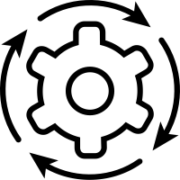
DevOps Culture
Operations
Developers
Testers
Seeks organizational stability
Seek change
Seek risk reduction

Slide 8
Development v/s Operations
Developers want change
Deliver bug-fixes, changes and new features.
The main task of the development team is to fulfil the customer’s requirements, test the solution, and provide software updates in quick succession. New features that have been implemented and tested by the developers add potential value for the customer.
On one hand, the development team wants change. On the other hand, the operations team is mainly interested in reliable and stable software environment. Every change forwarded by the development team can endanger the existing reliability and stability of production environment.

Slide 9
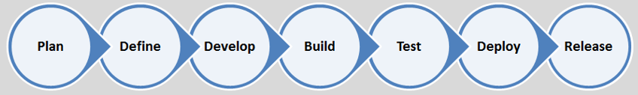
Development Methodologies - Comparison
Conception
Initiation
Analysis
Design
Construction
Testing
Deployment
Traditional
Deliverables
Requirements
Design
Code
Test
Deploy
Requirements
Design
Code
Test
Deploy
Agile
Iteration 1
Iteration 2
DevOps – workflow automation

Slide 10

DevOps in Business
DevOps Drivers
Market Competition
Ever-changing Business Needs
Quick to Market Requirement
Tight delivery deadlines
“The code works on my machine” – blame game
Disconnect bet’n Development and Operations team.
Conflict Scenarios
Conflict during deployment
Conflict after deployment
Conflict about performance

Slide 11

DevOps in Business
DevOps Drivers
Advantages of agile processes like Scrum, Kanban are often nullified because of the obstacles to collaboration, processes, and tools that are build up in front of operations.
Thus, achieving delivery timelines for a sprint becomes challenging.

Slide 12
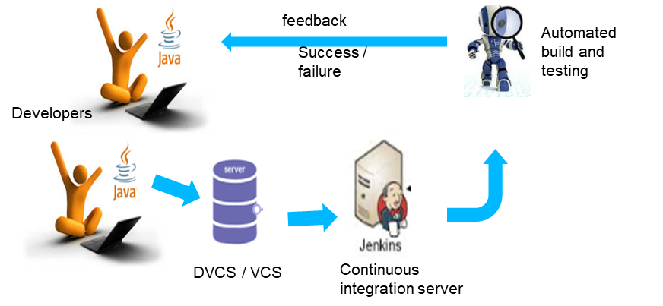
DevOps for QA
Continuous Testing enabled with, continuous integration.
Continuous integration is software development practice in which team members integrate their work frequently, leading multiple integrations per day.
WHAT PURPOSE DOES THIS SERVE?
1
Each integration helps to reveals integrations errors in build success / failures as quickly as possible.
2
Helps in significantly reducing integration problems and delivery timeline.
Notes:
Continuous integration is software development practice in which team members integrate their work frequently, leading multiple integrations per day.
Each integration helps to reveals integrations errors in build success / failures as quickly as possible.
This helps in significantly reducing integration problems and delivery timeline.

Slide 13

DevOps for IT Operations
Integrated Environment Provisioning
Dynamic Environment Provisioning
Containerized App Deployment and Data Center Management
Continuous Application Deployment
Single Click Deployment
Continuous Monitoring
Performance Monitoring
System and Application Monitoring
Log Analysis

Slide 14

DevOps for Business Owners
Quick to Market
Agility
Environment stability
Fast recovery
Fully automated deployments
Customer satisfaction
Improvement in product quality
Quick turn around time

Slide 15
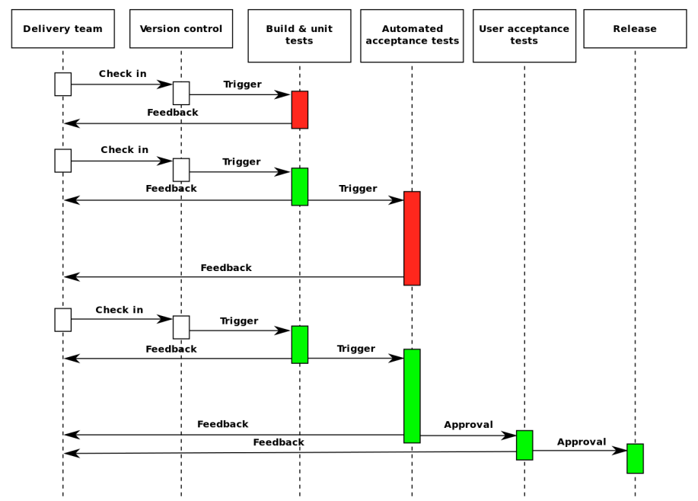
Continuous Delivery Pipeline
Source: Continuous Delivery: Reliable Software Releases through Build, Test, and Deployment Automation

Slide 16






Challenges in Implementing DevOps!
Establishing DevOps Culture
Implementing Change in Application Development Environment.
Environment Upgradation (standardization)
Application Complexity
Budget
Availability of Skillset

Slide 17
Best Practices in DevOps
Active partnership and close coordination among the stake holders in establishing DevOps culture.
Implement DevOps in totality. Avoid partial implementation, can become a reason for failure.
Choose right tool for each phase in DevOps implementation.
Best Practices
Options of substituting a exiting tools should be taken solicitously. No Fancy ideas.
Give equal importance to log analysis, report generation and circulation.
Mindset to adapt to changes.

Slide 18




DevOps Operational Benefits
Increased Agility
Improved Quality
To enable instant change deployment
To improve end user satisfaction
Improve Innovation
Reduced Outages
Less outages in production (about 80% outages are change related)
To increase innovation cycle

Slide 19
Maven and Gradle

Slide 20
Maven as App Build Automation
Apache Maven is a dependency management and a build automation tool,
primarily used for Java applications.
Conventional Attributes
1
Maven continues to use XML files just like Ant but in a much more manageable way.
2
Maven follows the rule of convention over configuration.
Advantages of Maven
Maven allows us to focus on what our build should do, and gives us the framework to do it.
Maven provides built-in support for dependency management.
Maven’s configuration file, containing build and dependency management instructions, is by convention called pom.xml.
Maven also prescribes strict project structure, while Ant provides flexibility there as well.
Notes:
Apache Maven is a dependency management and a build automation tool, primarily used for Java applications.
Maven continues to use XML files just like Ant but in a much more manageable way.
Maven follows the rule of convention over configuration.
Simply put, Maven allows us to focus on what our build should do, and gives us the framework to do it.
Another positive aspect of Maven is that it provides built-in support for dependency management.
Maven’s configuration file, containing build and dependency management instructions, is by convention called pom.xml.
Additionally, Maven also prescribes strict project structure, while Ant provides flexibility there as well.

Slide 21
Sample POM.xml File
Here’s an example of a pom.xml file for the same simple Java project with the HelloWorld main class from before:
<project xmlns="http://maven.apache.org/POM/4.0.0"
xmlns:xsi="http://www.w3.org/2001/XMLSchema-instance"
xsi:schemaLocation="http://maven.apache.org/POM/4.0.0
http://maven.apache.org/xsd/maven-4.0.0.xsd">
<modelVersion>4.0.0</modelVersion>
<groupId>baeldung</groupId>
<artifactId>mavenExample</artifactId>
<version>0.0.1-SNAPSHOT</version>
<description>Maven example</description>
<dependencies>
<dependency>
<groupId>junit</groupId>
<artifactId>junit</artifactId>
<version>4.12</version>
<scope>test</scope>
</dependency>
</dependencies>
</project>

Slide 22
Build Lifecycle
Validate
Lifecycle Phases
Generate sources
Process sources
Generate resources
Process resources
$ mvn compile
Compile
Process Classes
Generate Test-Sources
Test-Compile
$ mvn test
Test
Surefire Test
Prepare Package
$ mvn package
Package
Pre-integration Test
Integration Test
Verify
$ mvn install
Install

Slide 23



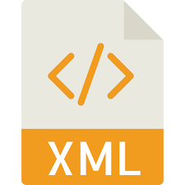

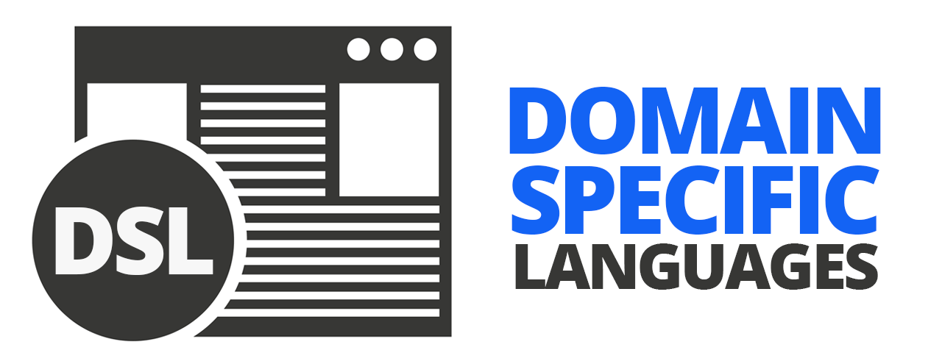

Gradle as Build Automation
Gradle is a dependency management and a build automation tool
which was built upon the concepts of Ant and Maven.
This led to smaller configuration files with less clutter since the language was specifically designed to solve specific domain problems.
Gradle’s configuration file is by convention called build.gradle.
Gradle gave its build steps name “tasks”.
Notes:
One of the first things we can note about Gradle is that it’s not using XML files, unlike Ant or Maven.
This was adopted by Gradle, which is using a DSL based on Groovy.
This led to smaller configuration files with less clutter since the language was specifically designed to solve specific domain problems.
Gradle’s configuration file is by convention called build.gradle.
Gradle gave its build steps name “tasks”.

Slide 24
Sample build.gradle File
Here is an example of a build.gradle file for the same simple Java project with the HelloWorld main class from before:
apply plugin: 'java'
repositories {
mavenCentral()
}
jar {
baseName = 'gradleExample'
version = '0.0.1-SNAPSHOT'
}
dependencies {
compile 'junit:junit:4.12'
}

Slide 25
Thank you!

